Slide 1
Effects of AP medication on cortical thickness and normative brain organization

Slide 2
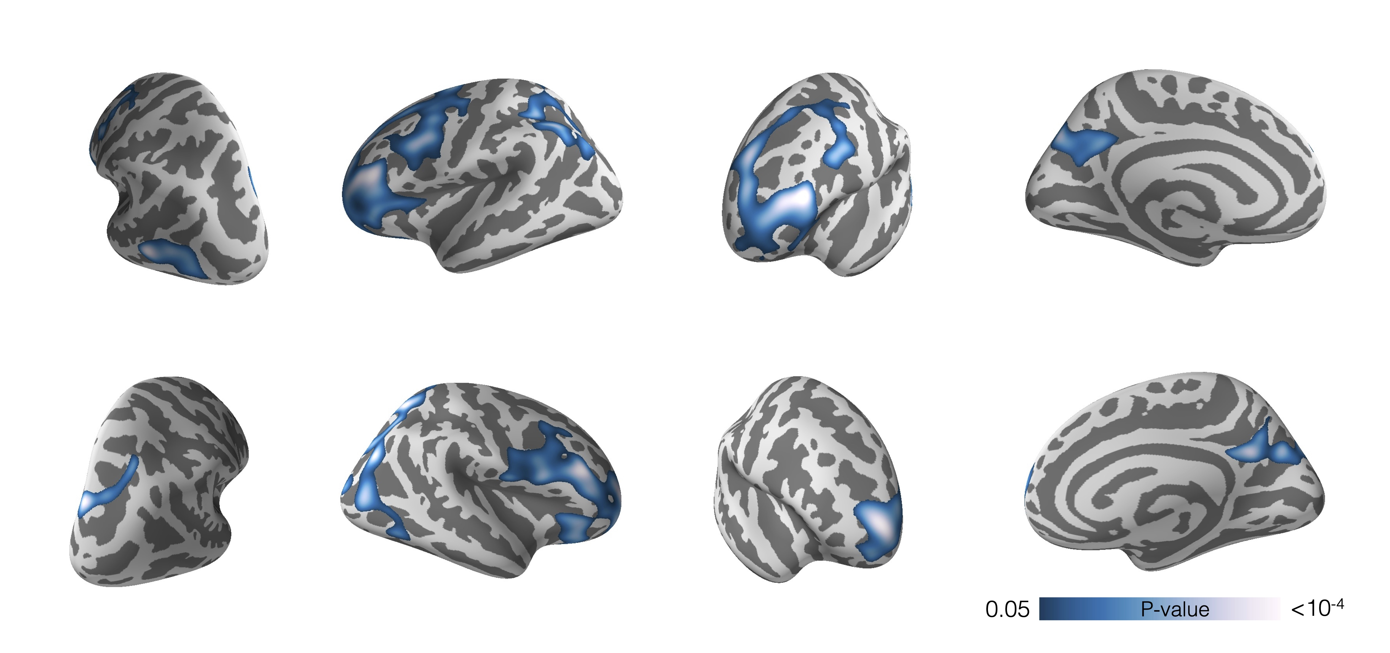
Figure 1 Association between lifetime antipsychotic exposure and cortical thickness. Higher lifetime AP exposure is associated with
lower cortical thickness in prefrontal cortex, parietal cortex and posterior
cingulate cortex, N=131. Model includes age, sex, and diagnostic group as nuisance variables. Colorbar indicates p-value and results are permutation corrected for multiple comparisons.

Slide 3
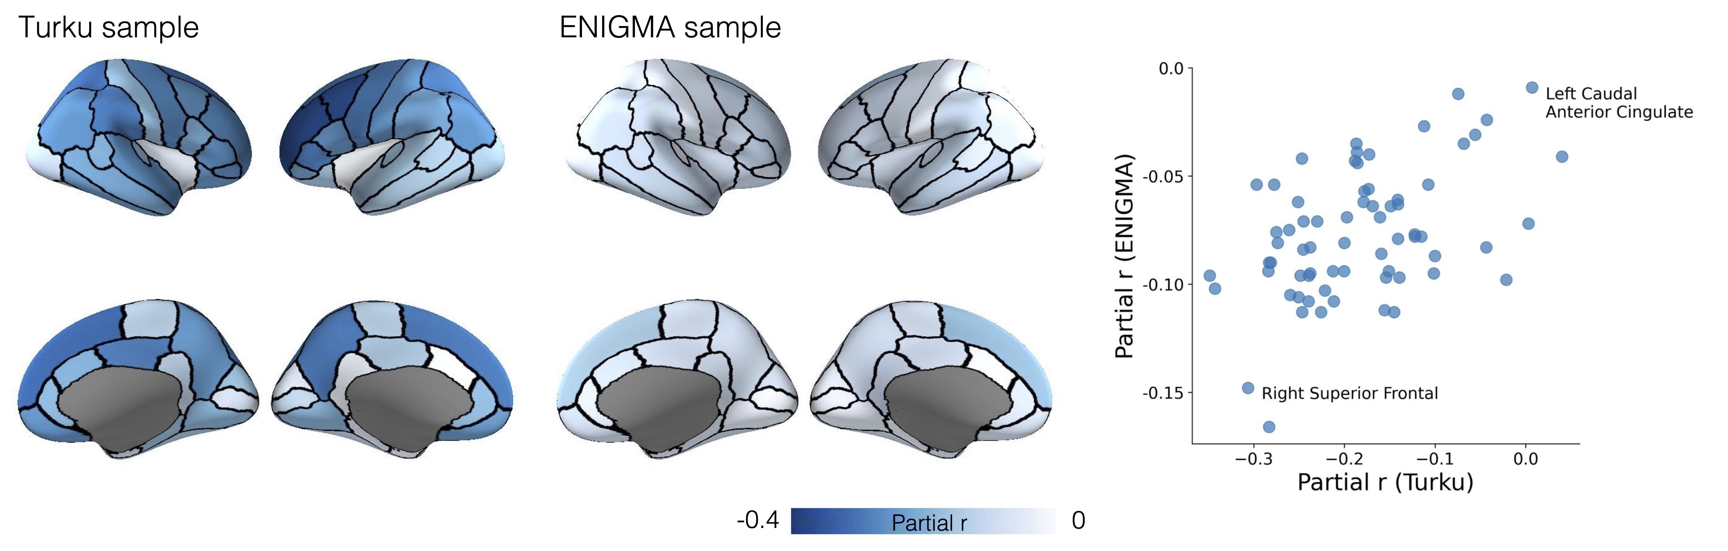
Figure 2 Parcel-wise associations between antipsychotic medication and cortical thickness in the Turku and ENIGMA samples. In the Turku sample, mean cortical thickness in each parcel and lifetime AP exposure are correlated while controlling for age, sex, and diagnostic group. In the ENIGMA sample, correlation between mean cortical thickness in each parcel and current AP dose is calculated while controlling for age and sex. Colorbar indicates partial correlation r. Spatial correlation of AP effects on cortical thickness is similar between the two samples (Pearson’s r=0.47, p_{spin} = 0.0008). Two regions with high and low sensitivity to antipsychotics are labeled in the scatter plot.

Slide 4
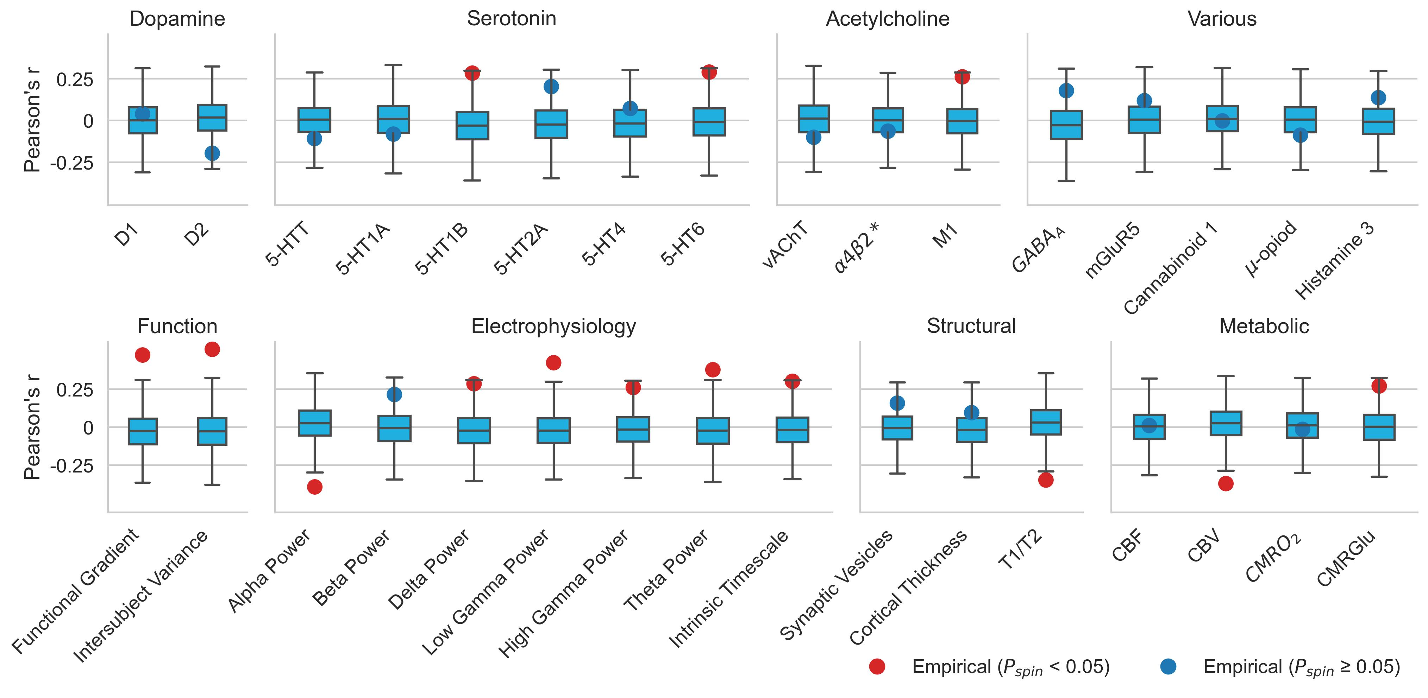
Figure 3 Regional sensitivity to antipsychotic exposure and underlying brain organization. Several statistically significant correlations between the effects of lifetime antipsychotic exposure and normative organization of the brain were discovered in the Turku sample. These include measures of serotonergic, cholinergic, structural, functional, electrophysiological, and metabolic features. Notably, correlation between the effects of antipsychotics and dopamine receptors was not statistically significant. Positive correlation indicates that regions that have a higher value of the measured brain feature are more susceptible to the effects of AP than regions that have a lower value and vice versa. The dots show Pearson’s correlation coefficient r between AP effects and a given brain feature, the color of the dot indicates statistical significance. The ends of the boxes represent the first and third quartiles and the center line represents the median of the null distribution (10,000 rotations), the whiskers represent the non-outlier end-points of the distribution

Slide 5
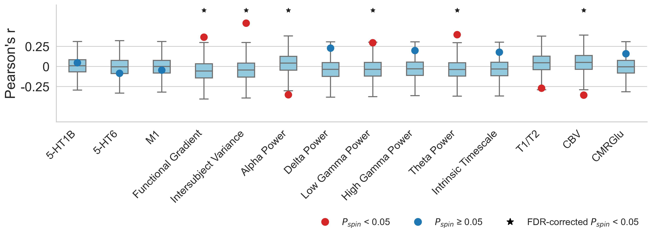
Figure 4 Antipsychotic sensitivity and brain organization replicated in the ENIGMA data. Fourteen (remove beta power) normative features of the brain discovered in the Turku sample were selected for a replication analysis. Associations between AP effects on cortical thickness and functional gradient, intersubject variance, alpha and theta power, and cerebral blood volume were replicated in the ENIGMA sample. In the boxplots the ends of the boxes represent the first and third quartiles, the center line represents the median of the null distribution (10,000 rotations), the whiskers represent the non-outlier end-points of the distribution

Slide 6
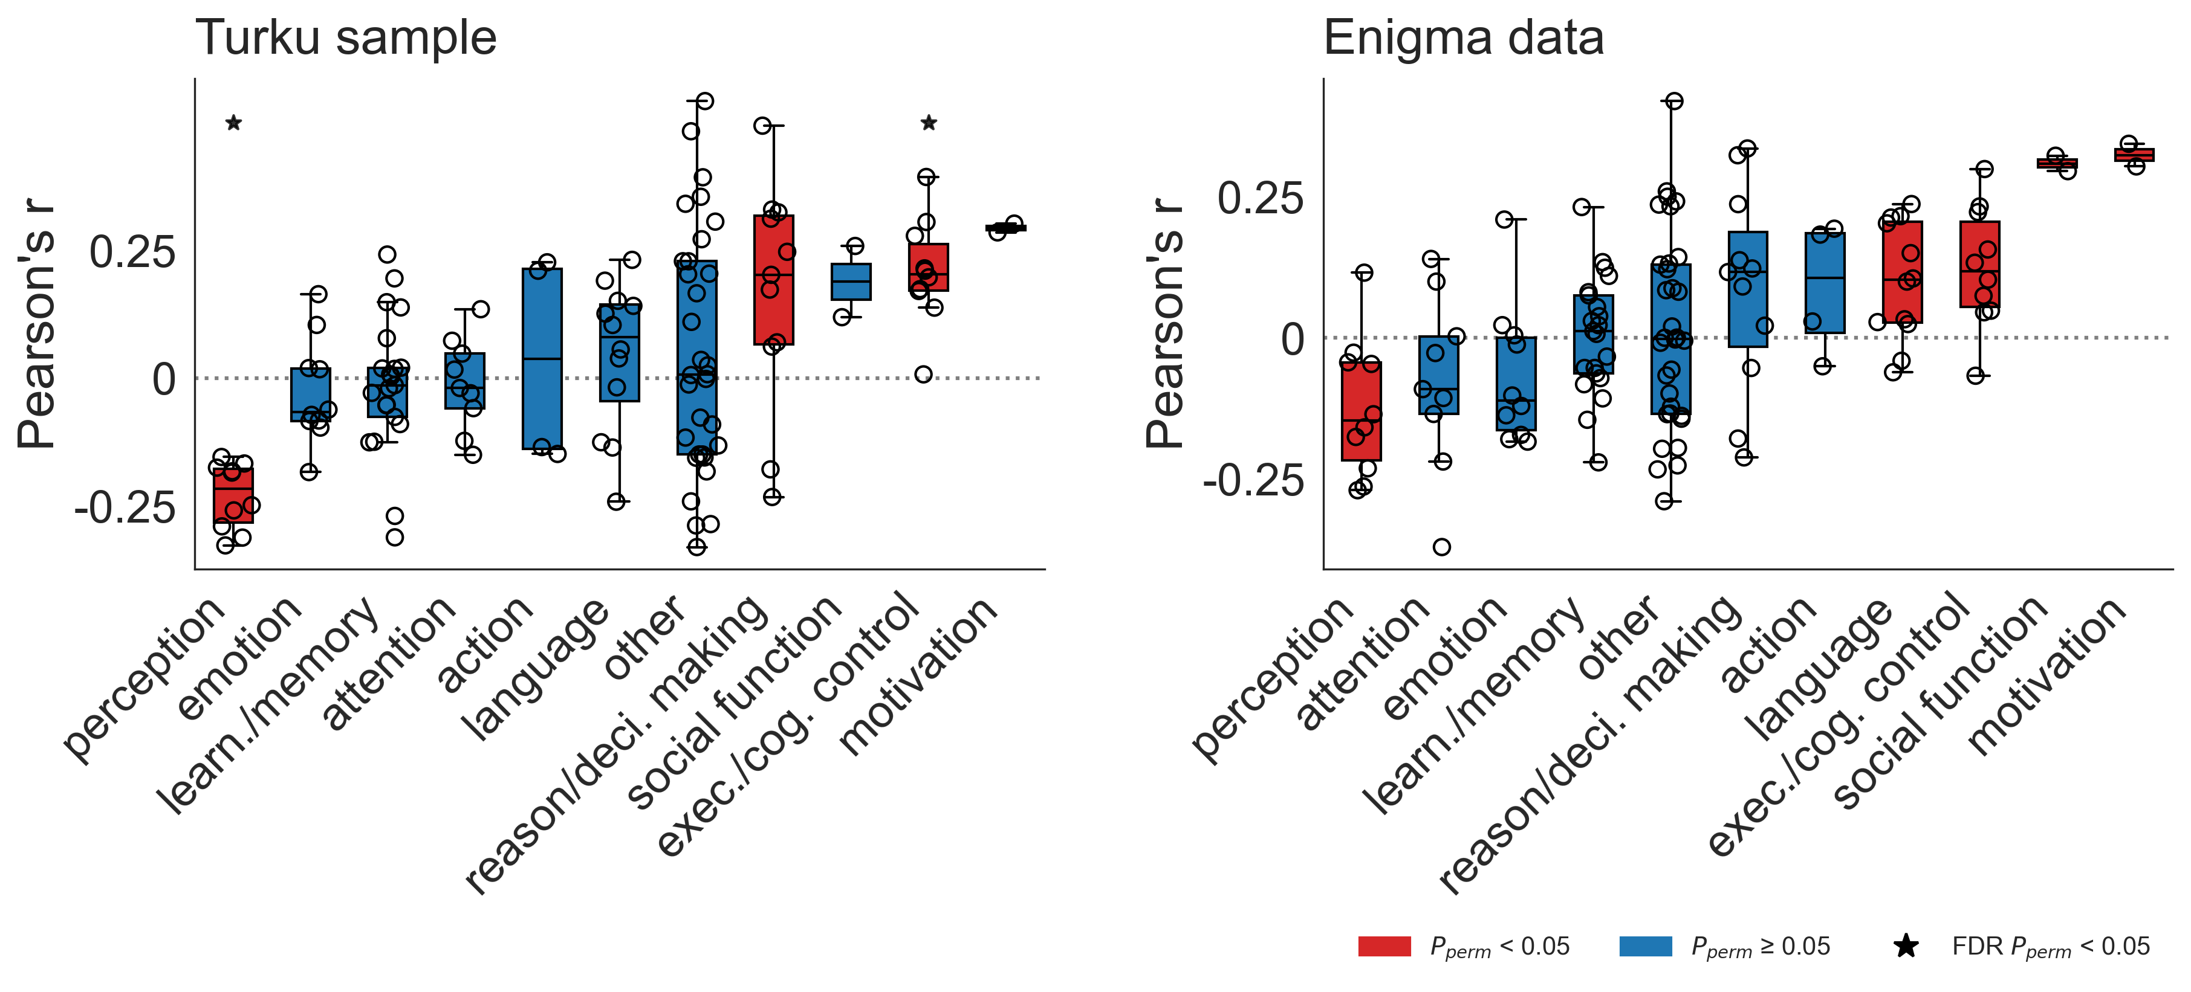
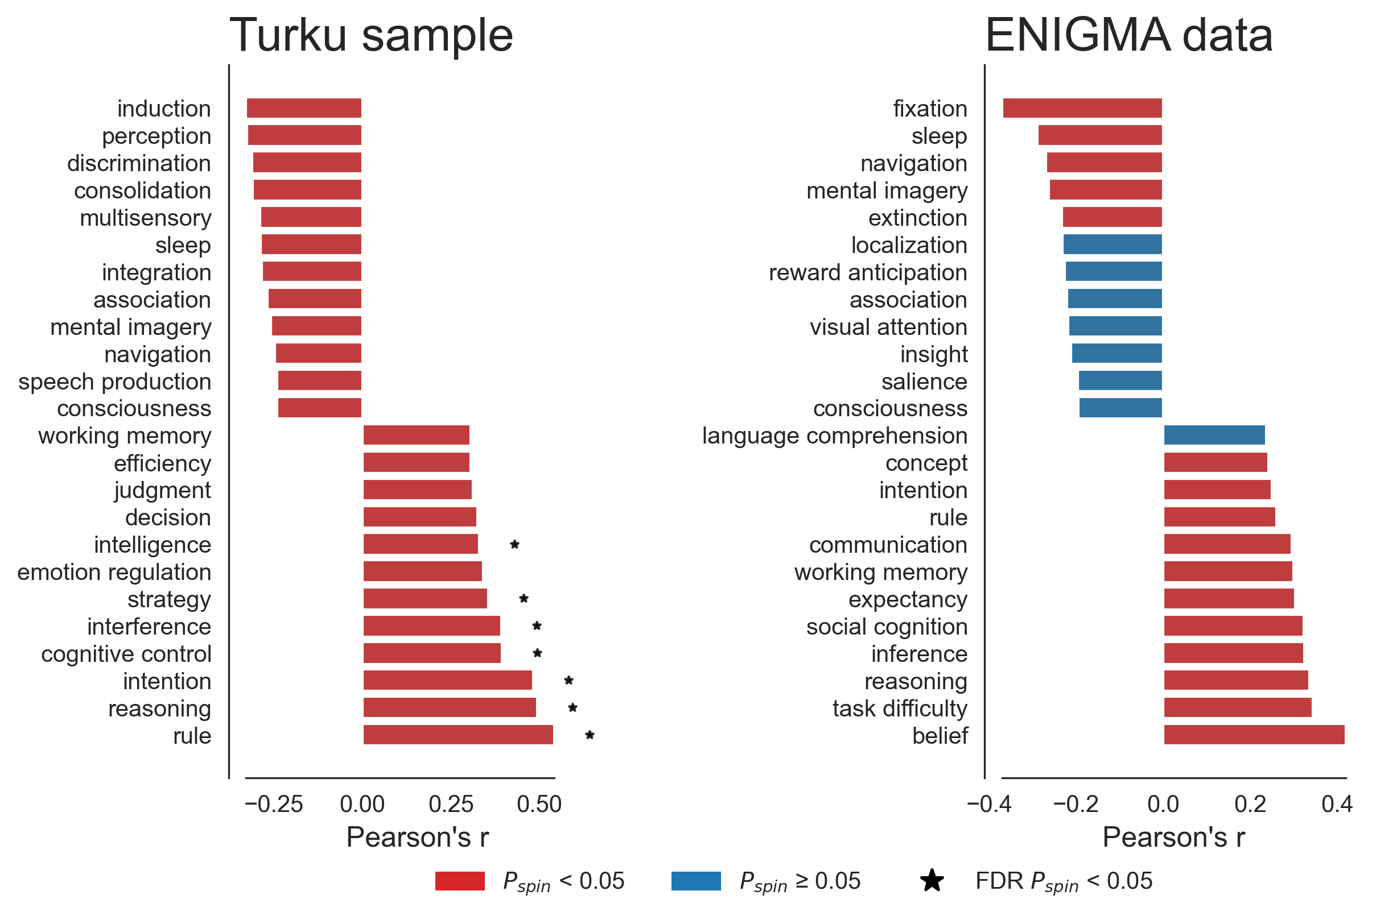
A)
B)
Figure 5 Antipsychotic related cortical thinning and cognitive functions. Probabilistic maps for 123 different cognitive functions were derived from neurosynth database and correlated with antipsychotic related cortical thinning. In the Panel A, he cognitive functions were grouped into 11 categories and ranked based on average correlation. In the Turku sample, we found that functions related to ‘perception’ were negatively correlated and ‘reasoning / decision making’, ‘executive / cognitive control ’ and ’motivation’ were positively correlated with antipsychotic related cortical thinning (two-sided permutation test over groupings). Similarly, in the ENIGMA data, ‘perception’, ‘executive / cognitive control ’, and ‘motivation’, but also ‘language’ and ‘social function’ were associated with antipsychotic related cortical thinning. Top and bottom 10 % of the strongest individual term correlations in both samples are shown in the Panel B.

Slide 7
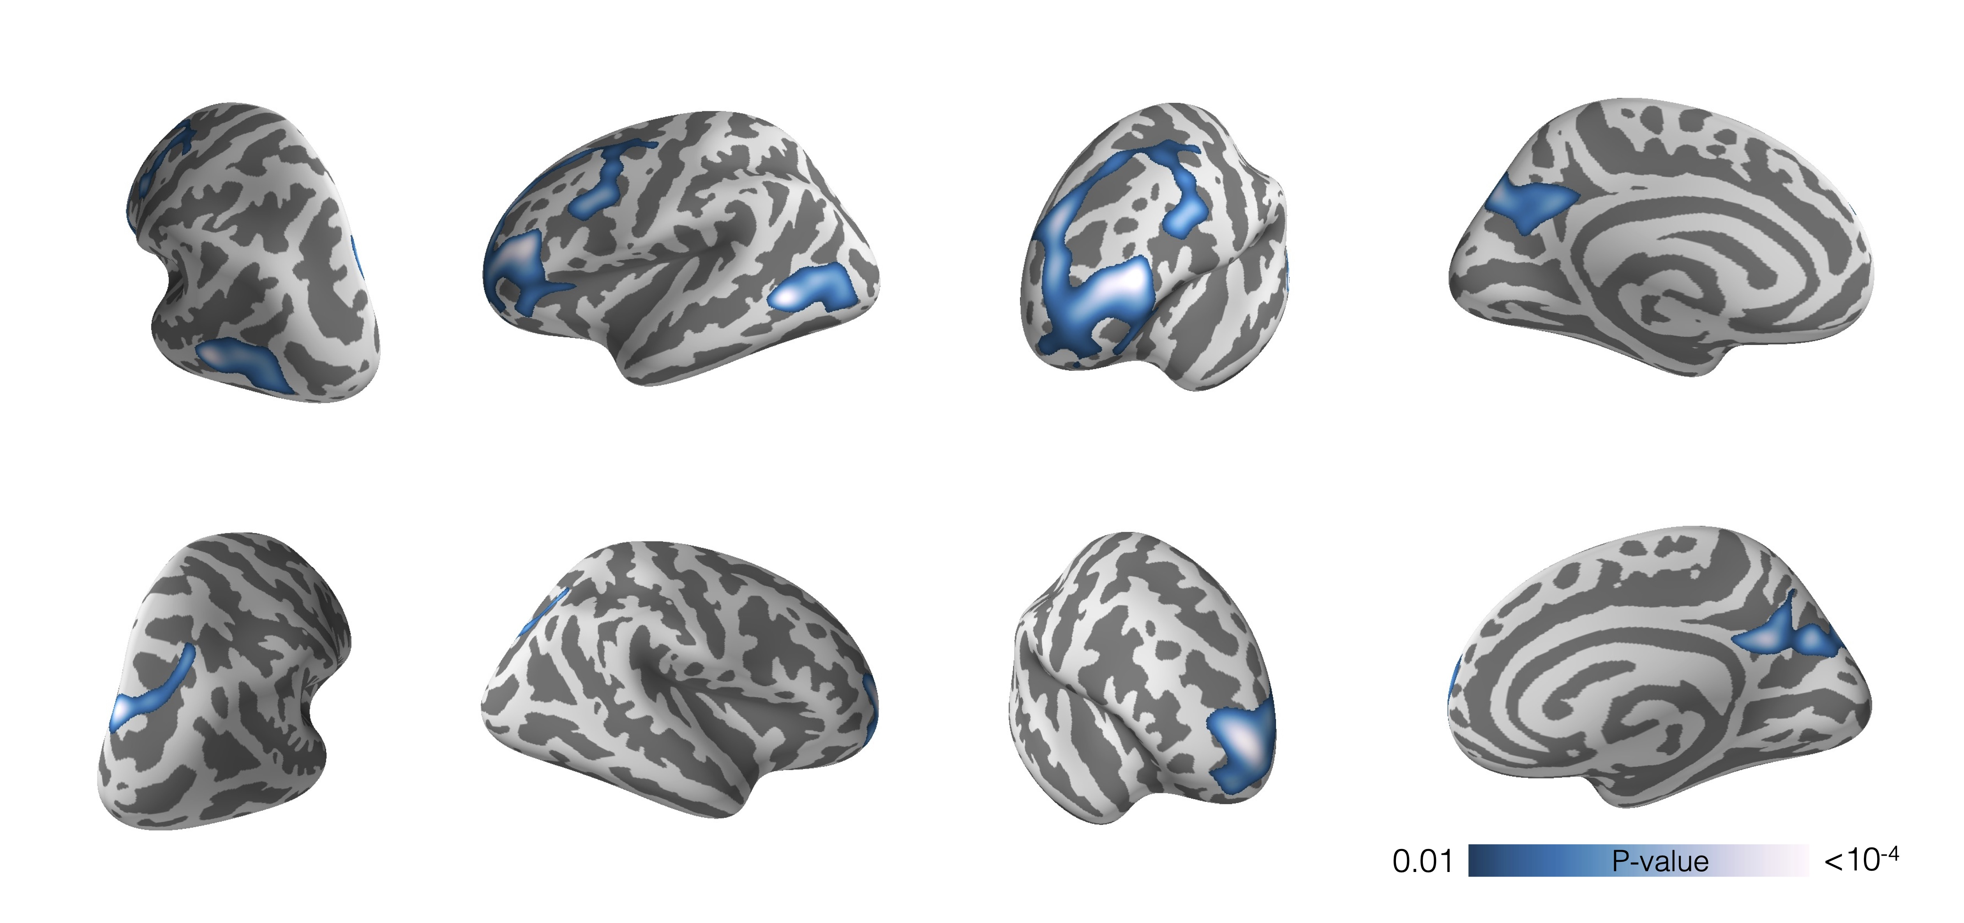
Supplementary Figure 1 Association between lifetime antipsychotic exposure and cortical thickness thresholded at p=0.01. Model includes age, sex, and diagnostic group as nuisance variables. Colorbar indicates p-value. Results are permutation corrected for multiple comparisons.

Slide 8
Supplementary Figure 2 Untresholded association between lifetime antipsychotic exposure and cortical thickness. Model includes age, sex, and diagnostic group as nuisance variables. Colorbar indicates p-value.

Slide 9
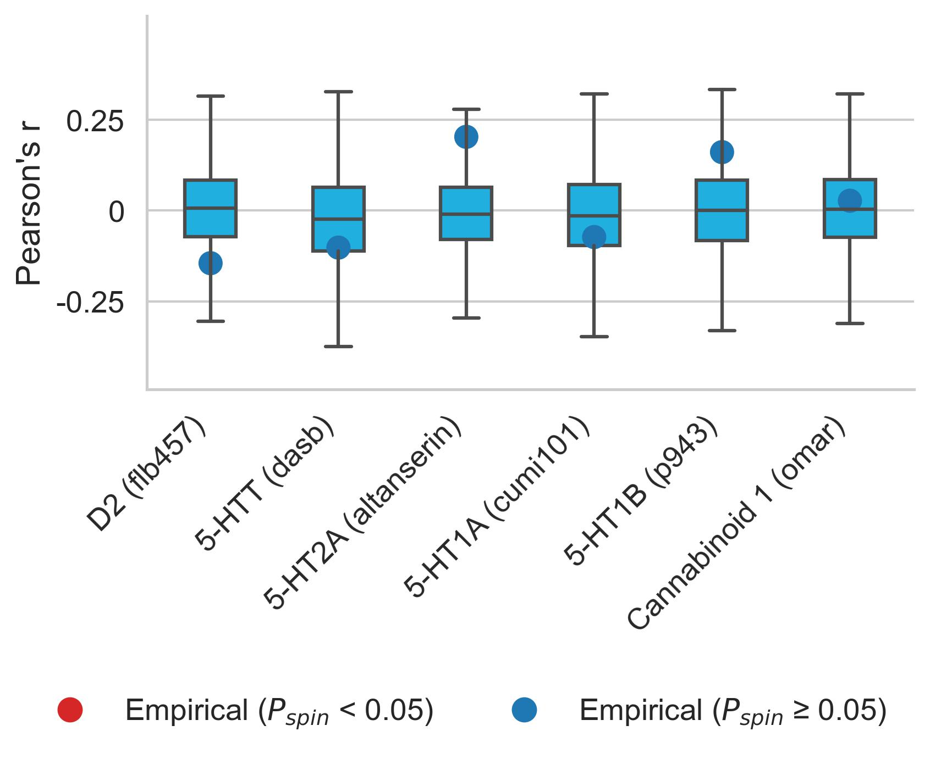
Supplementary Figure 3 Antipsychotic sensitivity and brain organization with additional measures. Six features of brain organization were measured with more than one tracer. For the sake of completeness, these measures were also correlated with AP effects on cortical thickness in the Turku sample. In line with the analysis using the primary measures for these features, no statistically significant associations were found.

